Slide 1


Presentation To
Healthcare Partners
1 December 2010

Slide 2
Data Exchange Dilemma
All healthcare providers desire improvement in the exchange and function of all collected data.
Current state-of-the art exchanges do not solve the internal needs to share all data nor allow providers an efficient means to view this data.
www.universalmedicalrecord.com © 2010 - 2013

Slide 3


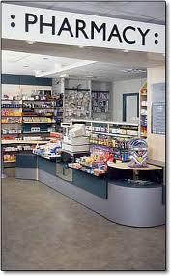

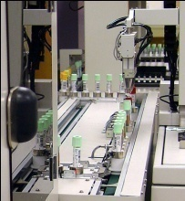

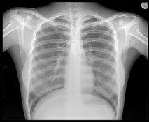





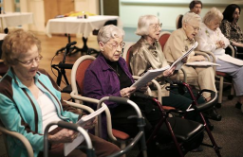
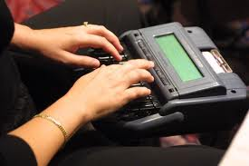
Healthcare Partners Today
Patient
Health Care Insurer
Laboratory
Access
Consent
Assisted
Living
?
Radiology
SHARED
DASHBOARD
Providers
Tele-health
Services
Scanned Documents
Transcription
Home care
Nursing home
www.universalmedicalrecord.com © 2010 - 2013

Slide 4
Universal Medical Records’ Solution
Integrate all of the healthcare providers via a web based HIPAA compliant UMR portal.
This portal maintains all standards of “CCD”, “HL7”, and “Meaningful Use”.
Give all healthcare providers a unique and clinically focused Dashboard for review of all data generated by its partners.
Provide tools to manage an ACO.
Allows all healthcare providers to become an exchange within its own.
www.universalmedicalrecord.com © 2010 - 2013

Slide 5
UMR Dashboard View
Review all patient-centric data compiled through medical disciplines‘ billing codes to formulate comprehensive patient-centered treatment plans.
  achieve quality outcomes
  improve patient safety
  reduce costs
  eliminate duplication
www.universalmedicalrecord.com © 2010 - 2013

Slide 6
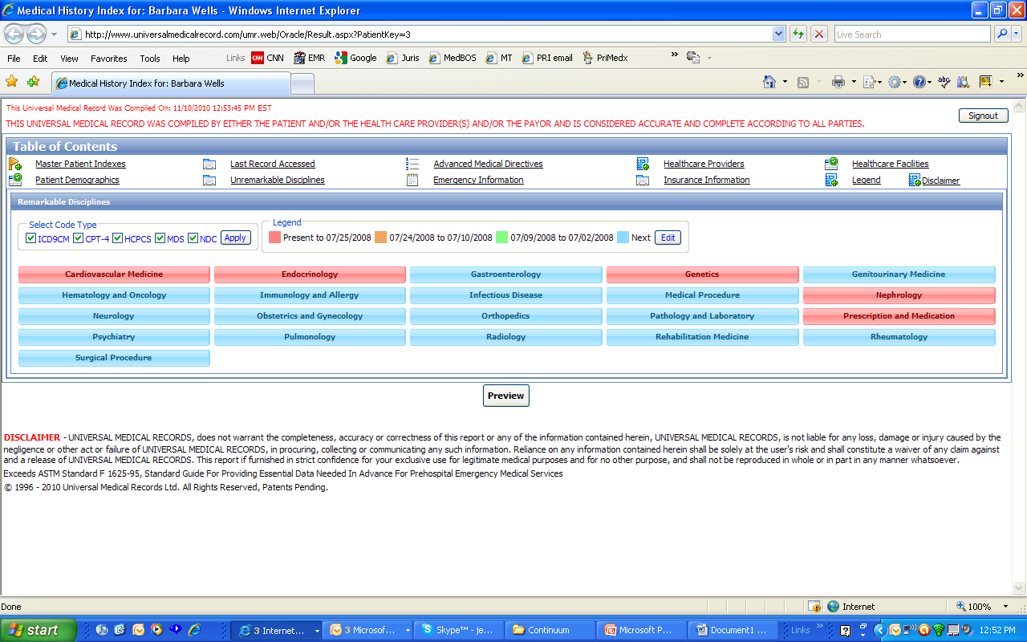
Healthcare Partners
Patient
Health Care Insurer
Laboratory
Access
Consent
Assisted
Living
?
Radiology
SHARED
DASHBOARD
UMR Dashboard
Providers
Tele-health
Services
Scanned Documents
Transcription
Home care
Nursing home
www.universalmedicalrecord.com © 2010 - 2013

Slide 7
The UMR view by Disciplines
Orthopedics
Medical Content Index
The next slide will demonstrate the unique organization by frequency and dates of all orthopedic codes
www.universalmedicalrecord.com © 2010 - 2013

Slide 8
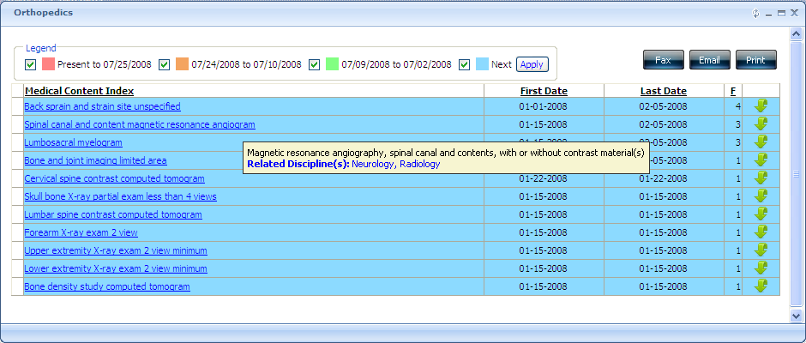
The UMR view by Disciplines
Orthopedics
Enhances collaboration between disciplines
Genealogy
www.universalmedicalrecord.com © 2010 - 2013

Slide 9
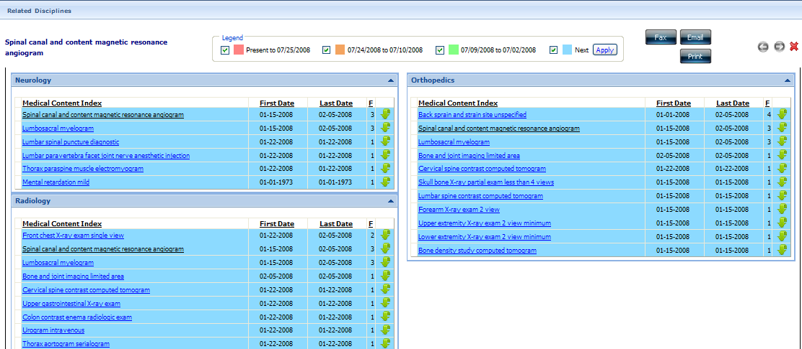
The UMR view by Disciplines Orthopedics
Communication Details
Provider ID
Healthcare Facility ID
The next slide demonstrates communications and demographics locator
www.universalmedicalrecord.com © 2010 - 2013

Slide 10
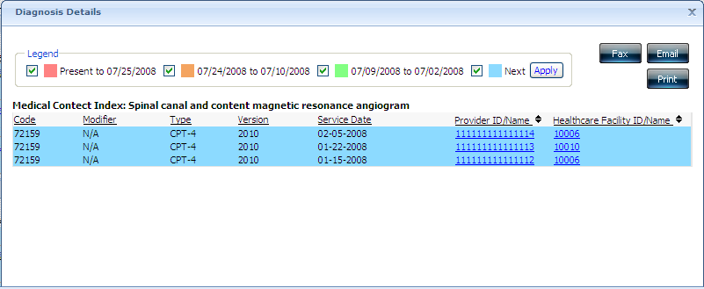
The UMR view by Disciplines Orthopedics
Communications and Demographics locator
www.universalmedicalrecord.com © 2010 - 2013

Slide 11
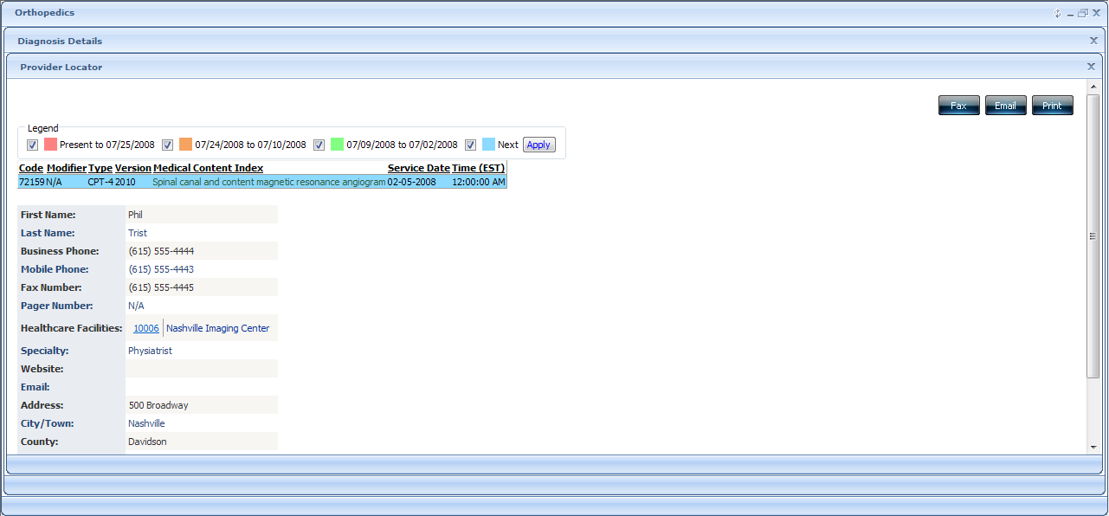
Breaking Down the Disciplines
Provider Locator
www.universalmedicalrecord.com © 2010 - 2013

Slide 12
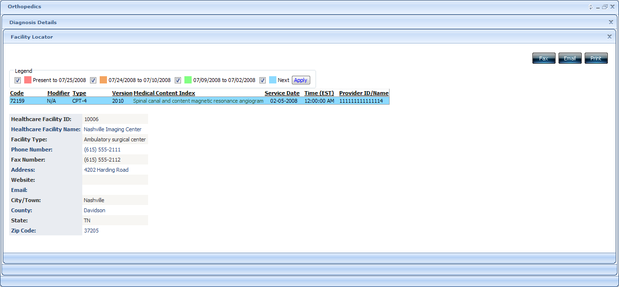
Breaking Down the Disciplines
Facility Locator
www.universalmedicalrecord.com © 2010 - 2013

Slide 13
Universal Medical Records’ Solution
Integrates all data to provide better management for the:
  Provider – Time saving from data mining; manages performance standards.
  Patient – Safety from comprehensive decision making through shared data.
  Payor – Improves quality and reduces errors/redundancy/costs/fraud and abuse.
Promotes infrastructure for ACO management and predictive modeling.
www.universalmedicalrecord.com © 2010 - 2013

Slide 14
Who is Universal Medical Record
Universal Medical Records (UMR) has been engaged in research and development efforts involving automated data records and medical/health care since 1996. Its primary focus has been the implementation of an integrated computerized patient medical record and the services associated with it for offering immediate and cost-effective on-line worldwide storage, access and retrieval.
Steven C. Cohn, M.D. CEO/President
Wayne O. Wells, M.D. Chief Medical Officer
www.universalmedicalrecord.com © 2010 - 2013

Slide 15
Return On Investment
Triage Center – profiling of patients
Removes Duplication
Maximizes disease management outcomes
HEDIS Criteria/Pay for Performance
Specificity coding remuneration for Medicare
Predictive Modeling – allocation of resources
www.universalmedicalrecord.com © 2010 - 2013

Slide 16
Return On Investment
Pharmaceutical incentives
Data Mining
  Securing Grants
  Research Opportunities
  Metric management
Malpractice Reduction
Corporate Compliance
www.universalmedicalrecord.com © 2010 - 2013

